Slide 1


DATA SCIENCE IN EMISSION CALCULATION
TEAM MEMBERS: HAN YIN, ERIC LI, GURMOL SINGH, HARSOVIN KAUR
MENTOR: LING BAI
Notes:
https://public.tableau.com/views/GHGs_16562633326860/12?:language=en-US&:display_count=n&:origin=viz_share_linkhttps://public.tableau.com/views/GHGs_16562633326860/12?:language=en-US&:display_count=n&:origin=viz_share_link

Slide 2
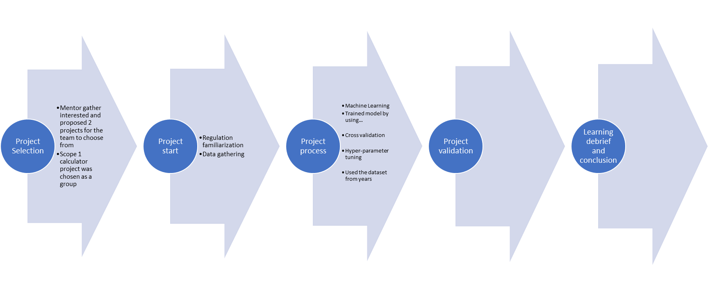
PROJECT DESCRIPTION
Compare to other calculators
Check with energy emission companies
Obtain more data over time
Carbon energy emissions increased over time
Companies have service level agreements to meet
Could cater to carbon credits

Slide 3
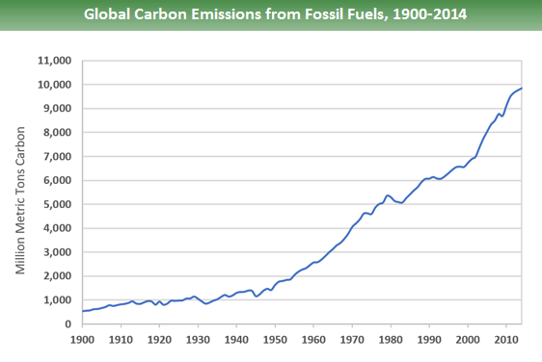
PROBLEM STATEMENT:
CO2 EMISSIONS HAVE INCREASED BY ABOUT 90% SINCE 1970.
THREE MAJOR IMPACTS OF INCREASE EMISSIONS INCLUDE-
ENVIRONMENTAL
- EXTREME CLIMATE CHANGE/ GLOBAL
WARMING
HUMAN HEALTH
-RESPIRATORY AND CARDIOVASCULAR
PROBLEMS
ECONOMICAL
-ECONOMICAL STRESS ON INDUSTRIES
CO2 Emissions
Impacts
Source: EPA 2014 report
Notes:
https://www.greenmatters.com/p/how-do-carbon-emissions-affect-environment
Global carbon emissions from fossil fuels have significantly increased since 1900. Since 1970, CO2 Emissions have increased by about 90%, with emissions from fossil fuel combustion and industrial processes contributing about 78% of the total greenhouse gas emissions increase from 1970 to 2011. (https://www.epa.gov/ghgemissions/global-greenhouse-gas-emissions-data)
For impacts refer to- https://www.canada.ca/en/environment-climate-change/services/environmental-indicators/greenhouse-gas-emissions-drivers-impacts.html
Paris agreement

Slide 4
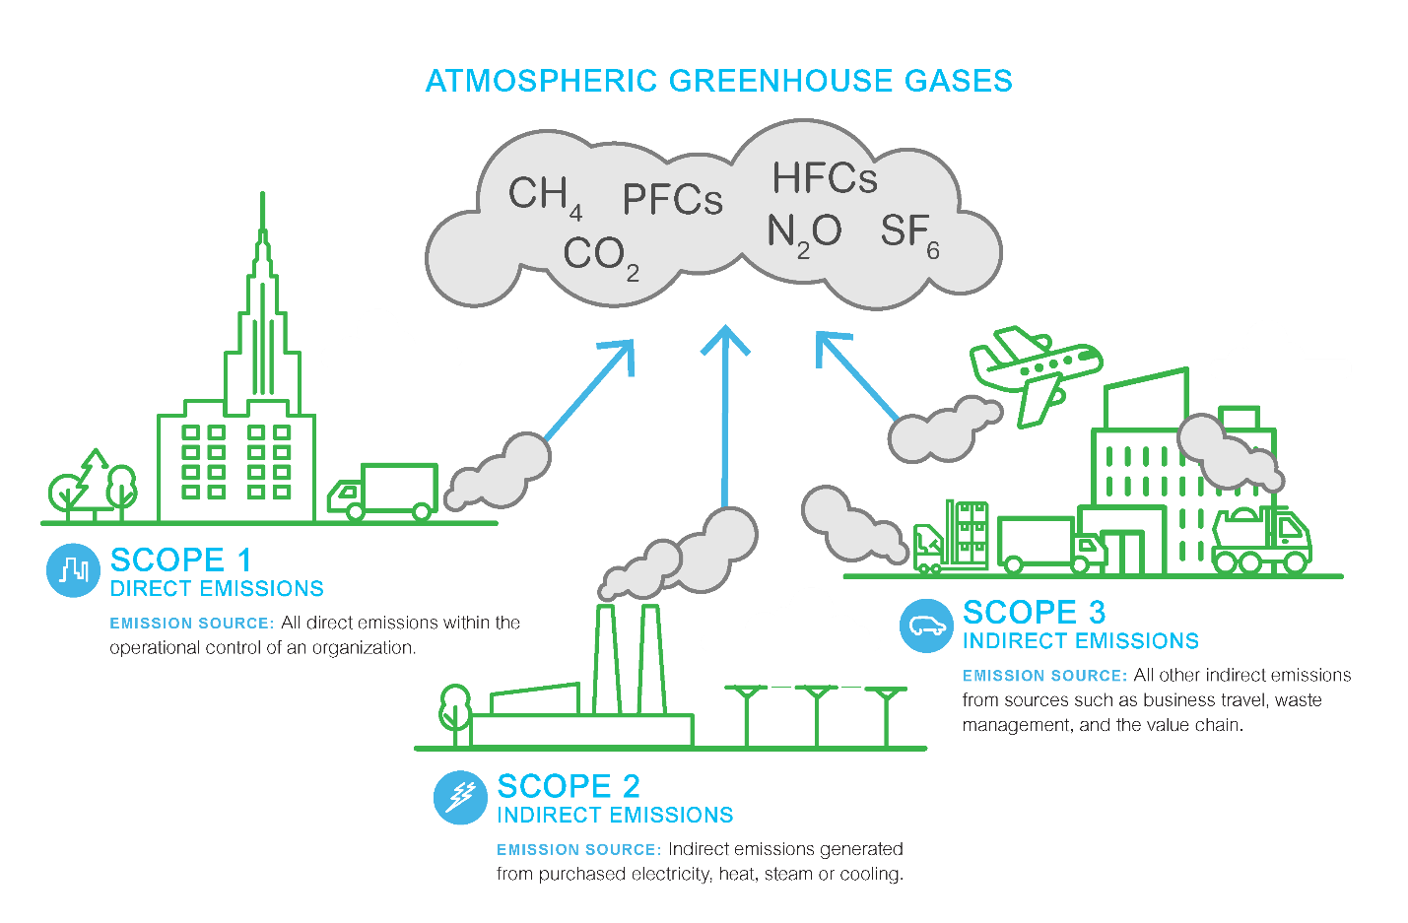
GHG PROTOCOL
GREENHOUSE GAS EMISSIONS ARE CATEGORISED INTO THREE GROUPS OR ‘SCOPES’ BY THE MOST WIDELY-USED INTERNATIONAL ACCOUNTING TOOL, THE GREENHOUSE GAS (GHG) PROTOCOL.
Notes:
Project 1, GHG Emission Scope 1.2.3 calculator
Scope 1 — This one covers the Green House Gas (GHG) emissions that a company makes directly — for example while running its boilers and vehicles.
Scope 2 — These are the emissions it makes indirectly – like when the electricity or energy it buys for heating and cooling buildings, is being produced on its behalf.
Scope 3 — Now here’s where it gets tricky. In this category go all the emissions associated, not with the company itself, but that the organization is indirectly responsible for, up and down its value chain. For example, from buying products from its suppliers, and from its products when customers use them. Emissions-wise, Scope 3 is nearly always the big one.

Slide 5
The 3 Scopes
The GHG Protocol outlines 3 emission scopes. Scope 1 and 2 must be reported, while Scope 3 is optional (as it's the hardest to monitor).
Scope 1: Direct Emissions
These are emissions released into the atmosphere from company-owned and controlled resources.
4 categories: stationary combustion, mobile combustion, fugitive emission, process emissions
Scope 2: Indirect Emissions - Owned
These are emissions released into the atmosphere from company-owned and controlled resources.
Includes all GHG emissions caused by the consumption of electricity, steam, heat, and cooling.
Scope 2 is about the energy consumed by the end-user.
Scope 3: Indirect Emissions - Not Owned
Scope 3 includes all indirect emissions (not included in scope 2) that occur in the value chain of the reporting company.
Energy consumed during transmission and distribution (employees, business travel, etc)
Includes both upstream (suppliers) and downstream (customers) emissions
Notes:
Project 1, GHG Emission Scope 1.2.3 calculator
Scope 1 — This one covers the Green House Gas (GHG) emissions that a company makes directly — for example while running its boilers and vehicles.
Scope 2 — These are the emissions it makes indirectly – like the electricity or energy it buys for heating and cooling buildings, is being produced on its behalf.
Scope 3 — Now here’s where it gets tricky. In this category go all the emissions associated, not with the company itself, but that the organization is indirectly responsible for, up and down its value chain. For example, from buying products from its suppliers, and from its products when customers use them. Emissions-wise, Scope 3 is nearly always the big one.

Slide 6
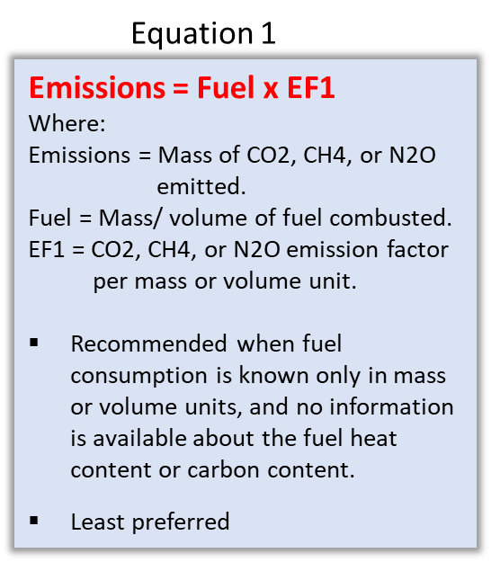
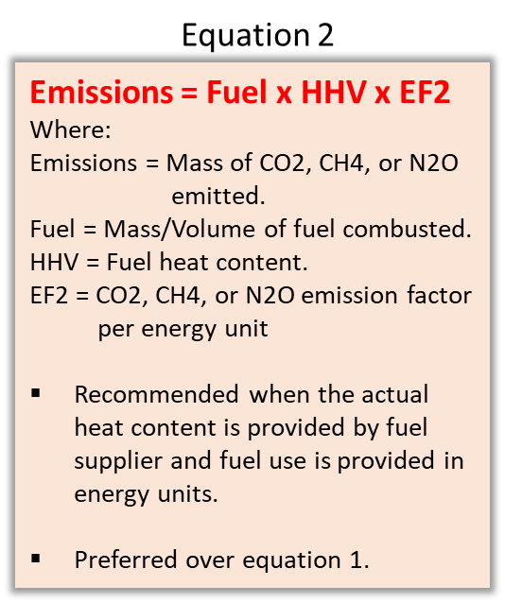
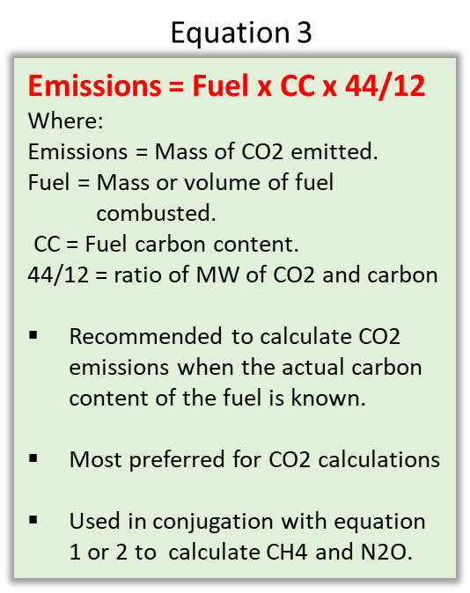
SCOPE 1 CALCULATION BY FUEL ANALYSIS METHOD
THE FUEL ANALYSIS METHOD TO CALCULATE CO2 EMISSIONS IS BASED ON FUEL-SPECIFIC INFORMATION OR DEFAULT EMISSION FACTOR TO DETERMINE THE CARBON CONTENT IN THE FUEL COMBUSTED.
Notes:
Might take 2 mins

Slide 7

PROPOSED SOLUTION/ FUTURE OBJECTIVE
CREATE A CARBON CALCULATOR TO GIVE COMPANIES INSIGHT ON HOW THEY CAN GET MORE CARBON CREDITS AND SAVE THE ENVIRONMENT
OBJECTIVES:
DEVELOPMENT OF REPORTING TOOLS
GHG CALCULATOR DEVELOPMENT REPORTING GREENHOUSE GAS EMISSIONS - CANADA.CA
NPRI CALCULATOR DEVELOPMENT REPORT TO THE NATIONAL POLLUTANT RELEASE INVENTORY - CANADA.CA
MSAPR DEVELOPMENT MULTI-SECTOR AIR POLLUTANTS REGULATIONS: FREQUENTLY ASKED QUESTIONS - CANADA.CA
EMISSION TRACKING DEVELOPMENT- GENERAL TOOL
Notes:
Sovin - first 7 slides

Slide 8

MACHINE LEARNING
PREPROCESSING OF MODEL BY COMBINING 17 YEARS WORTH OF CARBON EMISSIONS DATA AND CREATING CARBON EQUIVALENT VALUES. UNNECESSARY COLUMNS WERE DROPPED.
LIBRARIES USED WERE PANDAS, NUMPY, AND MATPLOTLIB AND FOLIUM AS WELL AS TABLEAU.
TRAINED MODEL BY USING TRAIN AND TEST DATA, THEN MADE A DECISION TREE REGRESSION.
CROSS VALIDATION - COMPARED DECISION TREE REGRESSION WITH RANDOM FORESTS REGRESSION.
HYPER-PARAMETER TUNING
Notes:
Eric
In our machine learning part, we use two models to train our data. First, it’s the decision tree regressor. It is a powerful model, capable of finding complex nonlinear relationships in the data. Second, we use Random forests by training many decision trees on random subset of the features, then averaging out their predictions.

Slide 9
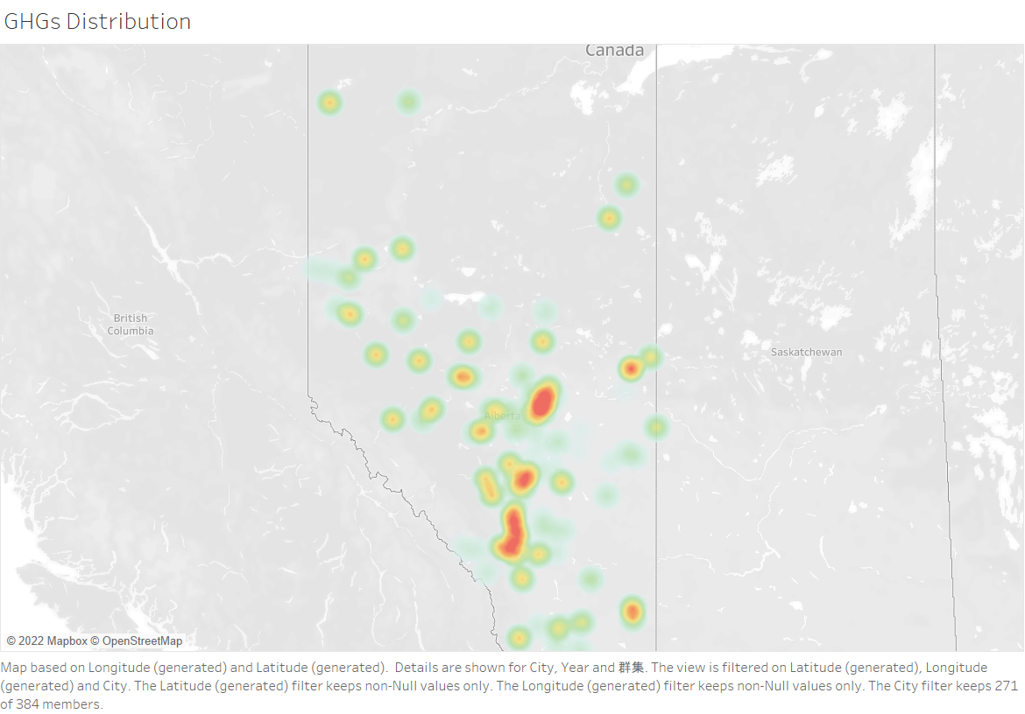
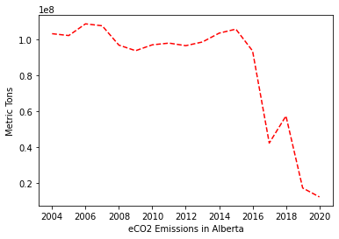
VISUALIZATIONS
SCATTERPLOT, TIME SERIES DATA, FOLIUM MAP WITH EMISSIONS
Notes:
Han
At the left side of our slide, it is a distribution map of total of the greenhouse gas emissions from 2004 to 2020. We can see that the most emission areas are mainly distributed around the two largest cities in Alberta, Edmonton and Calgary. The total emissions were dropped slightly in 2007 and 2008. Maybe caused by the recession of oil market, the Greenhouse gas emissions were sharply dropped from 2014 to 2017. After a short climbed up, it dropped again from 2018.

Slide 10
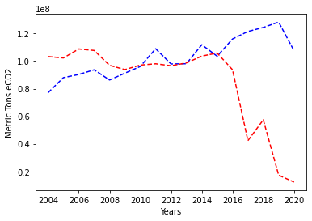
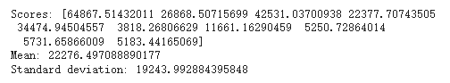
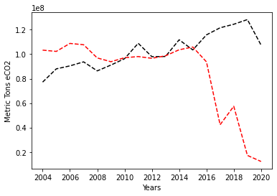

CROSS VALIDATION
Decision Tree Model
Random Forest Regressor

Slide 11
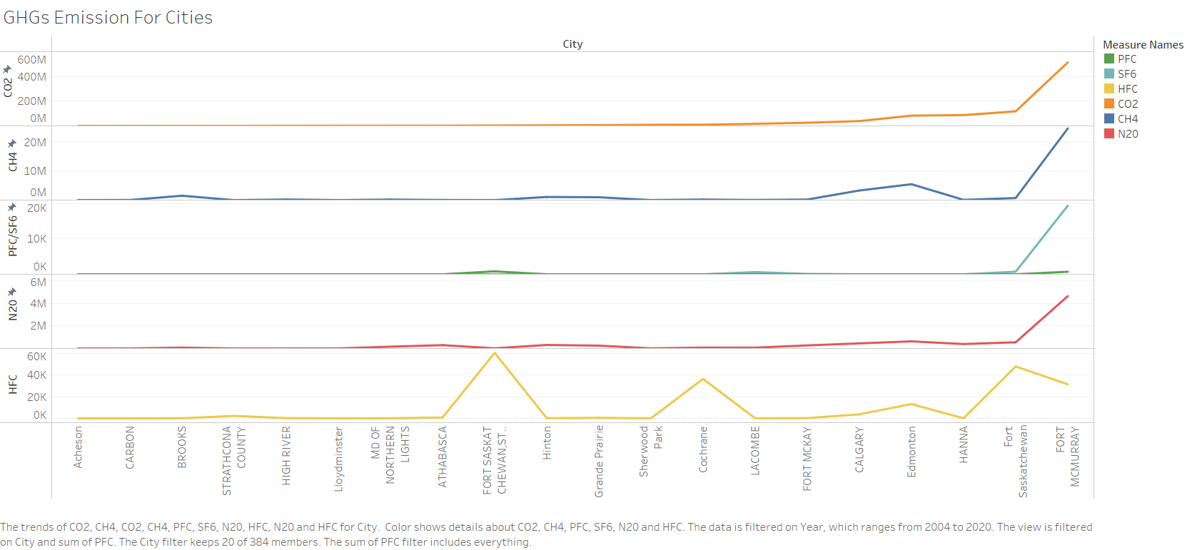
Notes:
The figure shows that the greenhouse gas emissions for every city. So we select the top 20 in here. As we can seen, fort mcmurry and fort saskatchewan are top 2 in this data since they have the most oil fields in Alberta.

Slide 12
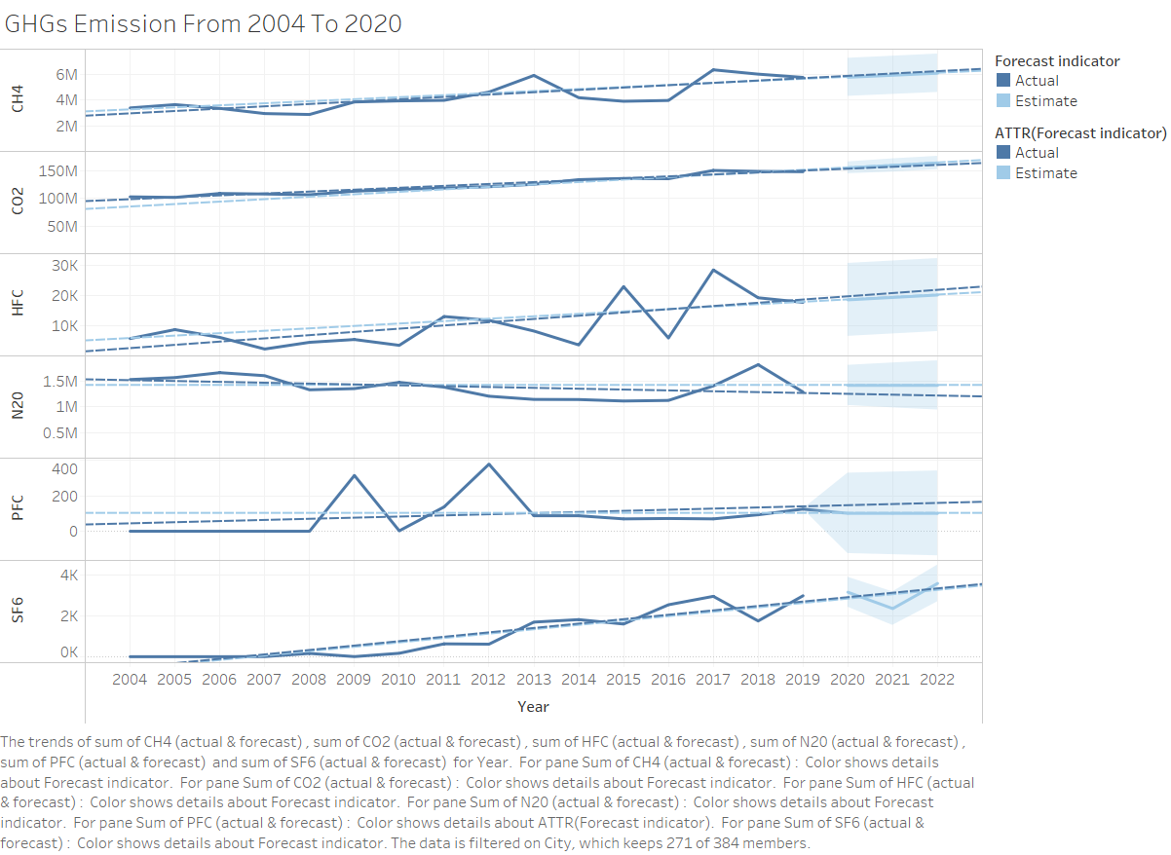
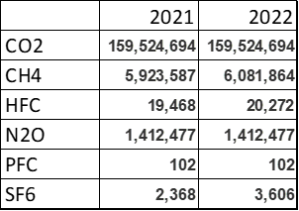
Prediction
GHGs
Tableau Public
Notes:
(slides 8 -12) In terms of the estimate Greenhouse gas emissions in the future two years. Except N2O and PHC, it seems that it is the time that the emission of other greenhouse gas were going to increase. Base on the uncertainty, the light blue box indicates the standard deviation.

Slide 14

END USERS
-COMPANIES WHO ARE GOING TO BE AFFECTED BY CARBON CREDITS
-INDIVIDUALS WHO ARE TRYING TO TRACK THEIR CARBON FOOTPRINT ON AN INDIVIDUAL LEVEL, THEY WOULD SUBMIT THEIR DATA TO AN APP

Slide 15
FUTURE DIRECTIONS
TOP CARBON PRODUCING COMPANIES:
GREENHOUSE 100 RANK PARENT CORPORATION OR ENTITY 2019 EMISSIONS (CO2 EQUIVALENT METRIC TONS)
1 VISTRA ENERGY 106,510,086
2 DUKE ENERGY 87,140,105
3 SOUTHERN COMPANY 86,244,286
4 BERKSHIRE HATHAWAY 74,960,726
WHERE EMISSIONS ARE COMING FROM:
“THESE ARE EMISSIONS GENERATED BY A CORPORATION'S OWN FACILITIES—FACTORIES, VEHICLES, POWER PLANTS—AND THE EMISSIONS GENERATED BY THIRD PARTIES FROM WHOM THE CORPORATION BUYS ENERGY. THESE EMISSIONS ARE EASY FOR CORPORATIONS TO MEASURE, AND RELATIVELY EASY FOR THEM TO CONTROL.”
HOW TO OPTIMIZE CARBON CREDITS:
THE TRADING OF CARBON CREDITS CAN HELP COMPANIES—AND THE WORLD—MEET AMBITIOUS GOALS FOR REDUCING GREENHOUSE-GAS EMISSIONS
Notes:
https://peri.umass.edu/greenhouse-100-polluters-index-current - top production
https://www.nrdc.org/experts/josh-axelrod/corporate-honesty-and-climate-change-time-own-and-act#:~:text=These%20are%20emissions%20generated%20by,easy%20for%20them%20to%20control. - where emissions come from
https://www.mckinsey.com/business-functions/sustainability/our-insights/a-blueprint-for-scaling-voluntary-carbon-markets-to-meet-the-climate-challenge - carbon credits

Slide 16
RECOMMENDATIONS
SYNERGIZE DATA AND EMISSION APPROACH
Identifying and quantifying CO2 emissions helps to identify excessive energy usage or other inefficiencies.
Lowering GHG emissions typically goes hand in hand with increasing efficiency and cost-effectiveness in a company's processes.
Data analytics, networked devices, sensors, and other digital technologies are changing how energy is used and consumed across the economy.
These technologies also create new opportunities to optimize energy use and decrease greenhouse gas emissions.
Notes:
Might take 1mins

Slide 17


